Slide 1
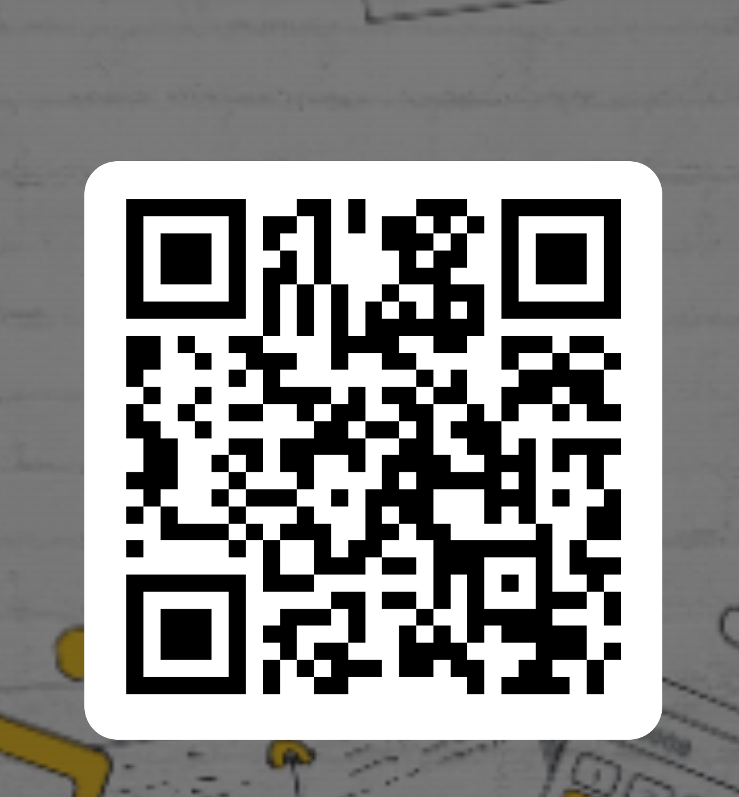
Fill in Attendance: https://forms.office.com/e/9xF4TLDXZZ
Done with attendance?
Come get the worksheets from the front.
Topics for this session:
Passive Voice
Conditionals
Adjectives & Adverbs
Choose what to start working on.
The PPTs are in the Teams environment to support your work.

